Slide 1

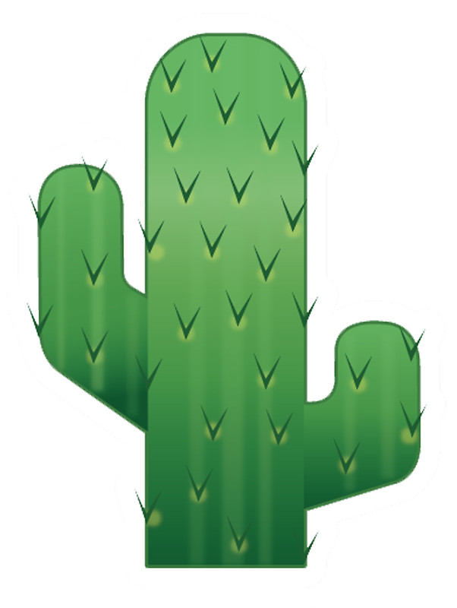

What is a standup bot?
Notes:
]

